Slide 1
State-Level Analysis

Slide 2
Agenda
Intro Statement
State Performance
Further Analysis
The Southeast
Summary

Slide 3
Introduction: Project Value
Why look at states?

Slide 4
Agenda
Intro Statement
State Performance
Further Analysis
The Southeast
Summary

Slide 5
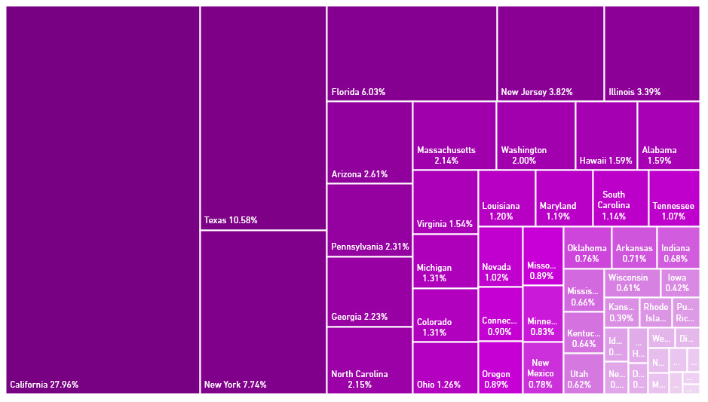
Sales Breakdown
California | 27.96%
Texas | 10.58%
New York | 7.74%
Florida | 6.03%
New Jersey | 3.82%
Illinois | 3.39%
Arizona | 2.61%
Pennsylvania | 2.31%
Georgia | 2.23%
North Carolina | 2.15%
Massachusetts | 2.14%
Washington | 2.00%
Hawaii | 1.59%
Alabama | 1.59%
Virginia | 1.54%
Michigan | 1.31%
Colorado | 1.31%
Ohio | 1.26%
Louisiana | 1.20%
Maryland | 1.19%
South Carolina | 1.14%
Tennessee | 1.07%
Nevada | 1.02%
States by % TTL US Sales
Note: Data from average days January 2019 through July 2020

Slide 6
Conversion Rate (No Promo)
Conversion rate varies from 1.5% to 3.3%. No discernible trend is present.
% of sessions ending in a purchase
Note: from 12 Jul 2019-12 Jul 2020

Slide 7
Customer Penetration
Customer Penetration demonstrates a huge range: 0.75% to 6.9%. California and Hawaii are tremendous outliers, illustrating their status as well-established states.
% of viable demographic captured
Penetration%
Note: Viable demographic considered women 18-45 and found using https://statisticalatlas.com/United-States/Overview. Data from Quay Lifetime Sales.

Slide 8
Facebook CAC
CAC is shown as decreasing here to be more easily comparable to other metrics. There exists also a large range: 21.5 to 8.3.
Facebook CAC
Customer Acquisition Cost (USD)
Note: Calculated from Facebook ad suite from 22 Apr to 15 Jul 2020 using average days only.

Slide 9
LTV
LTV varies hugely from state to state, with a minimum of 85 and a maximum of around 120. Southern states dominate the lower half.
Total customer value 1 year after acquisition
Lifetime Customer Value (USD)
Note: average day data

Slide 10
Agenda
Intro Statement
State Performance
Further Analysis
The Southeast
Summary

Slide 11
LTV/CAC (No Promo)
The LTV/CAC value acts as a rudimentary metric of the amount gained per dollar spent. For example, Arkansas, the state with the highest LTV/CAC, is earning back $10.46 or every dollar put in. Also, notice that CAC is the primary determinant, not LTV.
$ Gain per $ spent on ads

Slide 12
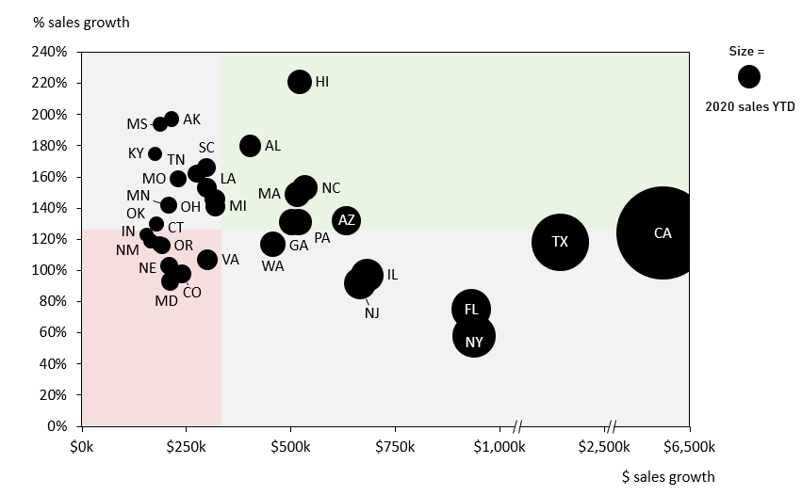
Title
Growth v Net Sales

Slide 13
Future Growth: Where is the Money Going to be
This graph shows the gain or loss each state is expected to experience if current growth rates continue. The data has been expressed as the percentage of total 2021 sales projected via this model. I.E. New York will drop from 6.37% to 4.54% of total US sales.
Change in % of TTL US Sales 2020-2021
Note: Made from Jan-Jul comparison between 2019 and 2020 average days

Slide 14
Seasonality Index
Seasonality Index (How seasonal a state is)

Slide 15
Blue Light
The table below shows states listed by the percentage of their sales that came from blue light. Various potential explanations and metrics were placed against this. Seasonality and penetration were notably unsuccessful, with AOV being a close fit.
Blue light as % TTL US Sales (Average Days)
Hawaii | 27.3%
DC | 26.0%
Oregon | 22.7%
Washington | 22.0%
Utah | 21.5%
South Dakota | 20.7%
Minnesota | 20.4%
Alaska | 19.9%
Nevada | 19.9%
Vermont | 19.4%
Montana | 19.0%
New Hampshire | 18.9%
Colorado | 18.6%
Virginia | 18.6%
Rhode Island | 18.4%
Iowa | 18.2%
California | 17.9%
Nebraska | 17.8%
Connecticut | 17.7%
North Dakota | 17.7%
Maryland | 17.7%
New York | 17.5%
Maine | 17.3%
Wisconsin | 17.3%
Florida | 17.1%
Pennsylvania | 17.1%
Michigan | 16.8%
Arizona | 16.6%
Massachusetts | 16.5%
Delaware | 16.3%
Indiana | 16.0%
Kansas | 15.9%
Ohio | 15.7%
New Jersey | 15.5%
Wyoming | 15.4%
Illinois | 15.2%
New Mexico | 14.5%
Idaho | 14.5%
North Carolina | 14.3%
Tennessee | 14.1%
Missouri | 14.0%
Oklahoma | 13.5%
Texas | 13.4%
Georgia | 13.4%
Arkansas | 12.9%
South Carolina | 11.9%
West Virginia | 11.5%
Puerto Rico | 11.5%
Kentucky | 11.3%
Louisiana | 10.0%
Alabama | 9.3%
Mississippi | 9.3%
Note: from average days Jul 2019 to Jun 2020

Slide 16
Collaboration Analysis
The tables shown here present the state “lift” ranks for each promotional event chosen. This lift represents the amount sales swelled versus the average of normal days in the same period. Essentially, how much did this event augment sales in each state.
JLO Lift Rank
Chrissy Teigen Lift Rank
Lizzo Lift Rank
1 | Puerto Rico
2 | New York
3 | New Jersey
4 | Florida
5 | Connecticut
6 | California
7 | Rhode Island
8 | Illinois
9 | Missouri
10 | Massachusetts
46 | Tennessee
47 | Arkansas
48 | Mississippi
49 | Kansas
50 | Alabama
1 | Utah
2 | Washington
3 | Colorado
4 | Tennessee
5 | Wisconsin
6 | Massachusetts
7 | North Carolina
8 | Virginia
9 | Nevada
10 | New York
46 | Alabama
47 | Mississippi
48 | South Carolina
49 | Oklahoma
50 | Indiana
1 | Nebraska
2 | Oregon
3 | Minnesota
4 | Kansas
5 | Iowa
6 | Indiana
7 | Oklahoma
8 | Illinois
9 | Wisconsin
10 | Washington
46 | South Carolina
47 | West Virginia
48 | Arkansas
49 | Hawaii
50 | Alabama

Slide 17
State by State Focus
Selected 15 of the most important states based on growth data and other metrics. These will be the states I go into deeper analysis with, and draft strategic suggestions for.
State | Growth | AOV | CAC | LTV | Penetration | Population
California | Mid | High | Low | High | High | 39M
Texas | Mid | High | Mid | High | High | 27M
New York | Low | High | Low | High | High | 20M
Florida | Low | Mid | Mid | High | High | 20M
Illinois | Low | Mid | High | High | Mid | 13M
New Jersey | Low | High | Low | High | High | 9M
Georgia | Mid | Mid | Low | Low | Mid | 10M
North Carolina | High | Low | Mid | Low | Mid | 10M
Massachusetts | High | Mid | High | Mid | High | 7M
Hawaii | High | High | High | High | High | 1.4M
Alabama | High | Low | Low | Low | High | 5M
Louisiana | High | Low | Mid | Mid | Mid | 5M
South Carolina | High | Low | Mid | Low | Mid | 5M
Tennessee | High | Low | Mid | Low | Low | 7M
Missouri | High | Low | High | Low | Low | 6M
2020 sales YTD

Slide 18
Agenda
Intro Statement
State Performance
Further Analysis
The Southeast
Summary

Slide 19
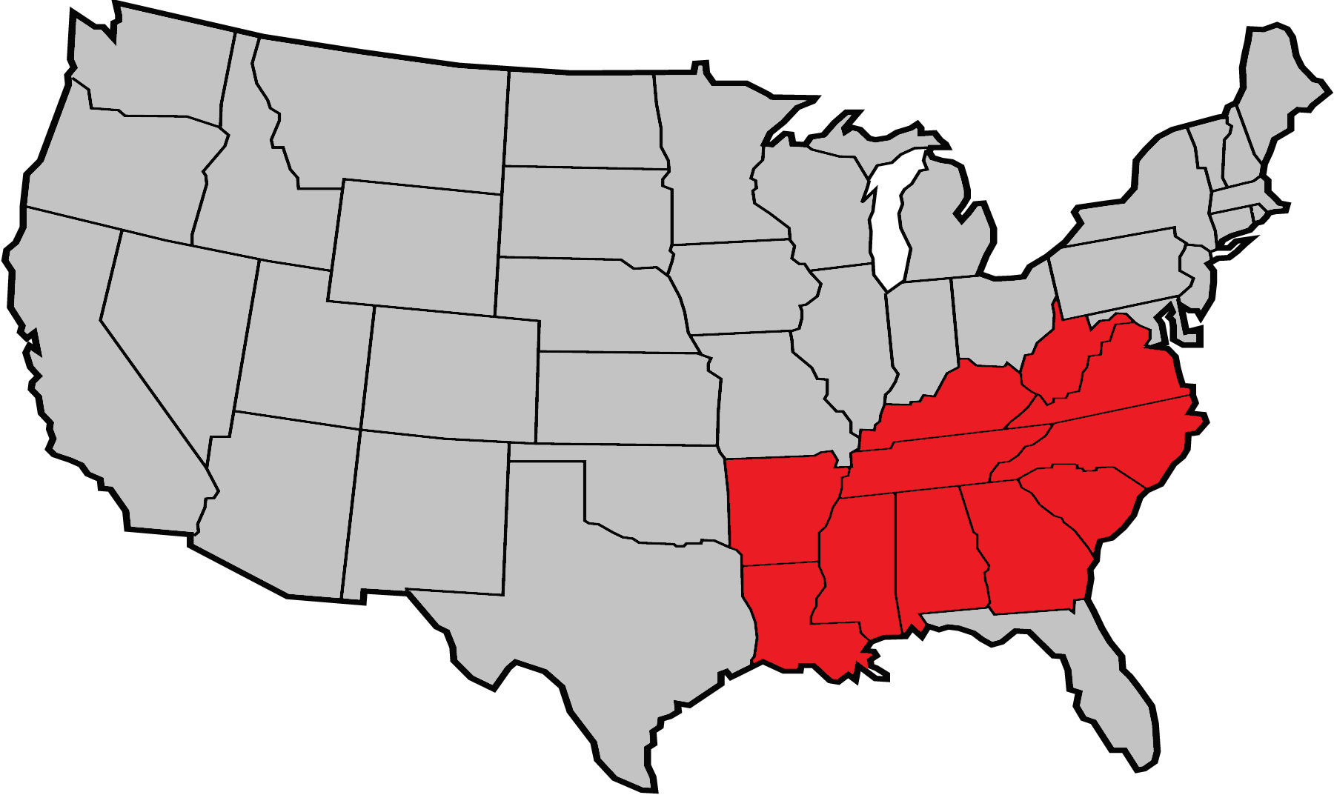
Defining the Southeast
Map is clearly geographically intuitive, but it also represents similar underlying stats.
Florida has been excluded from this grouping due to its unique and wildly different metrics (e.g. its growth of 76% versus the southeastern 154%)
New region has profound value: now these states are comparable to majors.

Slide 20
Southeastern Growth
% sales growth
Size =
HA
AR
2020 sales YTD
MS
AL
KY
TN
SC
MO
LA
OH
MI
NC
S. East
MN
MA
OK
OR
AZ
IN
GA
PA
TX
CA
NM
CT
VA
WA
IL
NV
CO
NJ
MD
FL
NY
$0k
$500k
$1,000k
$2,500k
$3,000k
$6,500k
$ sales growth

Slide 21
Future Growth: The Southeast
Here the regional grouping of the southeast has been added, to demonstrate the regional nature of the growth trend. Total shift share shift is 4.6%, with 2.15% of this being southeastern.
Change in % of TTL US Sales 2020-2021
Note: Made from Jan-Jul comparison between 2019 and 2020 average days

Slide 22
Southeastern Metrics
This table is here to allow for the comparison between the Southeast and major states. Southeastern growth is far above all others shown here. Although AOV and LTV are low, so is CAC. This means, as shown by the LTV/CAC, that although states have a lower return, they have a lower cost to match. The final piece is the low penetration, which can be seen by comparing population and sales.
State | Growth | AOV | CAC | LTV | LTV/CAC | Penetration | 2020 Sales YTD | Population
California | Mid | High | Low | High | High | High | 11.5M | 39M
Texas | Mid | High | Mid | High | Mid | High | 4.4M | 27M
New York | Low | High | Low | High | High | Mid | 2.5M | 20M
Florida | Low | Mid | Mid | Mid | Mid | Mid | 2.2M | 20M
Southeast | High | Low | Low | Low | Mid | Low | 5.7M | 84M

Slide 23
Agenda
Intro Statement
State Performance
Further Analysis
The Southeast
Summary

Slide 24
Summary of Insights
The US is a tremendously large market which can and should be split into smaller markets that demonstrate similar consumer habits.
The traditional strongholds of the business aren’t necessarily the markets of the future.
The southeast demonstrates tremendous potential as a growth opportunity.

